Slide 1
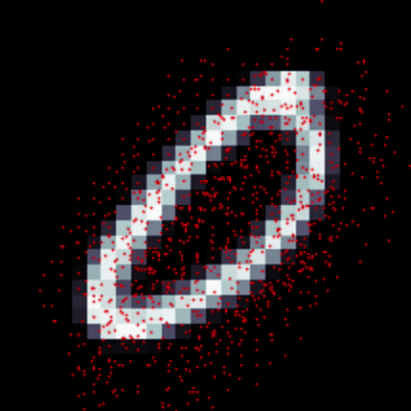
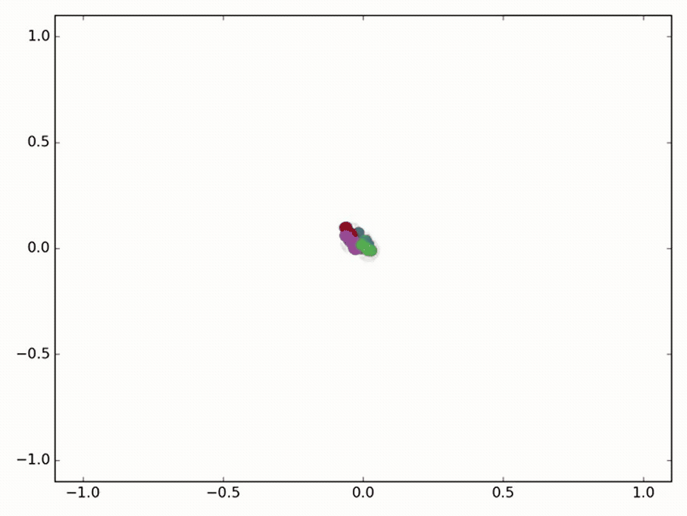
Geometric Convolutions Presented by: Anand Bhattad (2nd year of MS, CS)
Deformable Convolutional Networks (ICCV’17)
Graph Neural Networks (ICLR‘17, ICLR’18)
CS598 BL: Adversarial Machine Learning Instructor: Prof. Bo Li

Slide 2
Outline
Deformable Convolutions
Motivation and Contribution
How they work?
Benefits
Graph Neural Networks
Why graph neural networks?
How they are different from CNNs?
Few problems using graph networks
Notes:
Hand Crafted (invariant) Features –difficult/infeasible on complex transformation even when they are known

Slide 3
Deformable Convolution Networks
Dai, Jifeng, Haozhi Qi, Yuwen Xiong, Yi Li, Guodong Zhang, Han Hu, and Yichen Wei. "Deformable Convolutional Networks." ICCV (2017).

Slide 4
Motivation
Fixed Geometric Structures in current CNNs
Invariant to Geometric Variations/Spatial Transformations
Scale
Pose
Viewpoint
Deformation
Inter-class variation
Hand Crafted (invariant) Features
Generalization to new tasks
Notes:
Hand Crafted (invariant) Features –difficult/infeasible on complex transformation even when they are known

Slide 5
Motivation
Fixed Geometric Structures in current CNNs
Invariant to Geometric Variations/Spatial Transformations
Scale
Pose
Viewpoint
Deformation
Inter-class variation
Hand Crafted (invariant) Features
Generalization to new tasks
Notes:
Hand Crafted (invariant) Features –difficult/infeasible on complex transformation even when they are known

Slide 6
Motivation
Fixed Geometric Structures in current CNNs
Invariant to Geometric Variations/Spatial Transformations
Scale
Pose
Viewpoint
Deformation
Inter-class variation
Hand Crafted (invariant) Features
Generalization to new tasks
Notes:
Hand Crafted (invariant) Features –difficult/infeasible on complex transformation even when they are known

Slide 7
Motivation
Fixed Geometric Structures in current CNNs
Invariant to Geometric Variations/Spatial Transformations
Scale
Pose
Viewpoint
Deformation
Inter-class variation
Generalization to new tasks
Notes:
Hand Crafted (invariant) Features –difficult/infeasible on complex transformation even when they are known

Slide 8
Contribution
Deformable convolution – Convolution + Learnable offset
Deformable RoI pooling – RoI Polling + Learnable offset

Slide 9
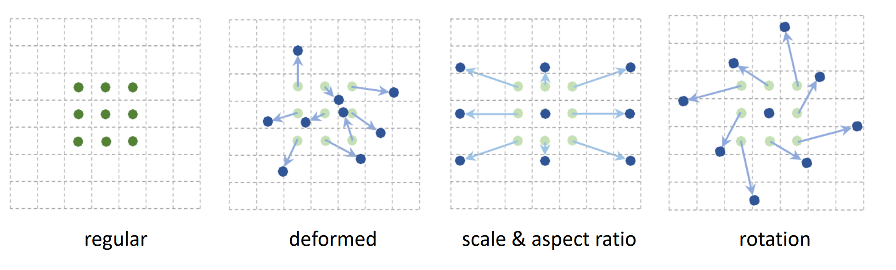
Contribution
Deformable convolution – Convolution + Learnable offset
Deformable RoI pooling – RoI Polling + Learnable offset

Slide 10
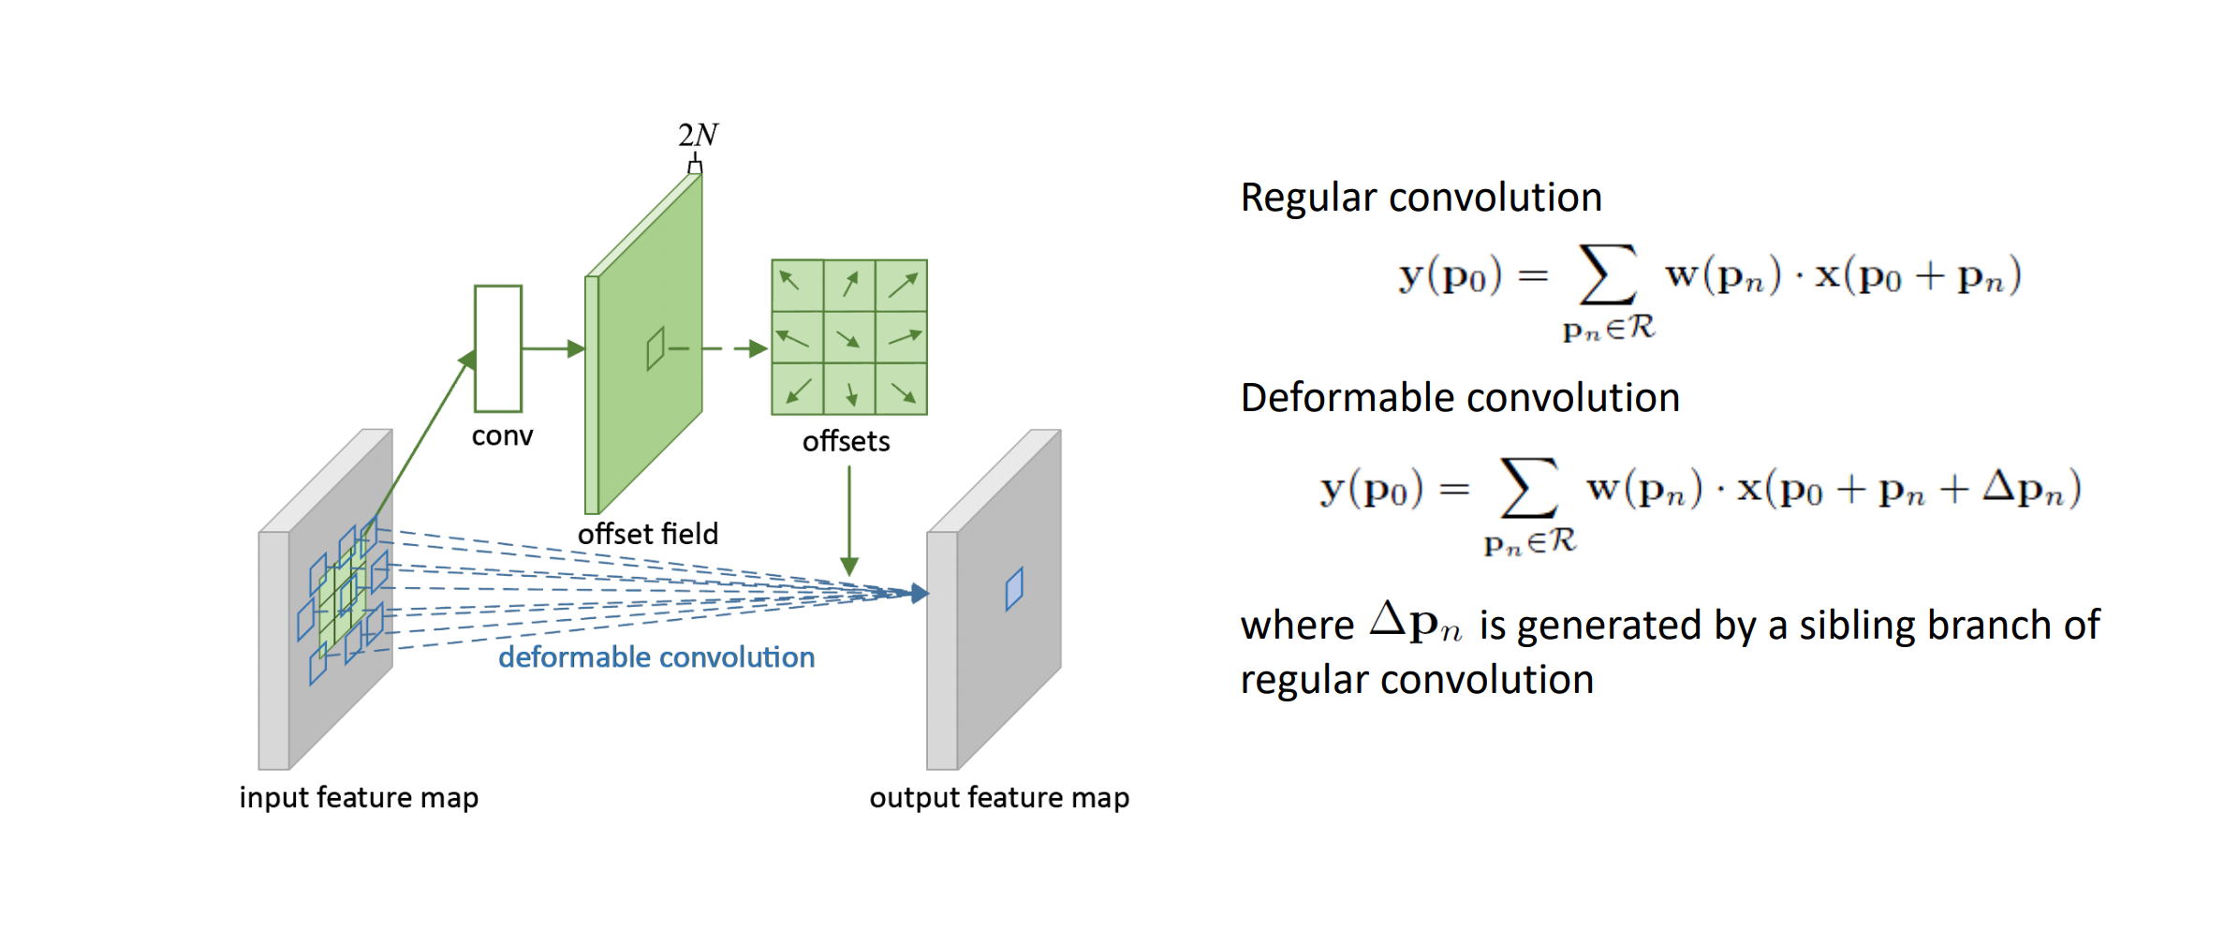
Deformable Convolutions
Two Branches
Regular conv. layer
another conv. layer to learn 2D offset
Generalized /“learnable” dilated convolution
Notes:
In this diagram, the regular conv. layer is fed in the blue squares instead of the green squares.

Slide 11
Deformable Convolutions
Two Branches
Regular conv. layer
another conv. layer to learn 2D offset
Generalized /“learnable” dilated convolution
Notes:
In this diagram, the regular conv. layer is fed in the blue squares instead of the green squares.

Slide 12
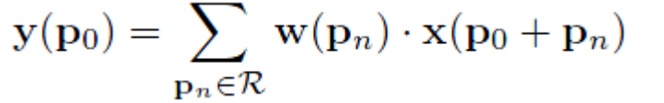
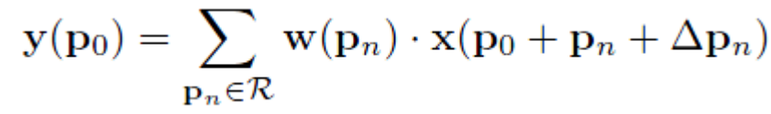
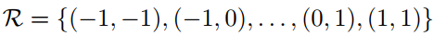
Deformable Convolutions
Regular convolution
Deformable convolution
Notes:
In this diagram, the regular conv. layer is fed in the blue squares instead of the green squares. | offsets do not need to be specifically regularized

Slide 13
Deformable Convolutions
Regular convolution
Deformable convolution
Notes:
In this diagram, the regular conv. layer is fed in the blue squares instead of the green squares. | offsets do not need to be specifically regularized

Slide 14
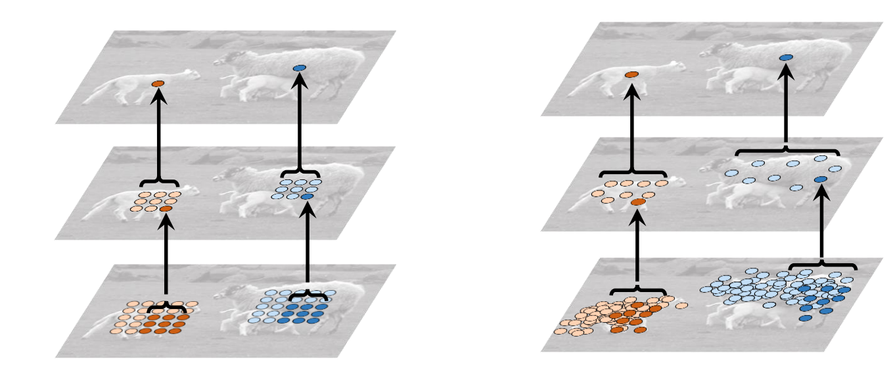
Benefits
Local, Dense and Adaptive

Slide 15
Benefits
Local, Dense and Adaptive
Dynamic and learnable receptive field

Slide 16
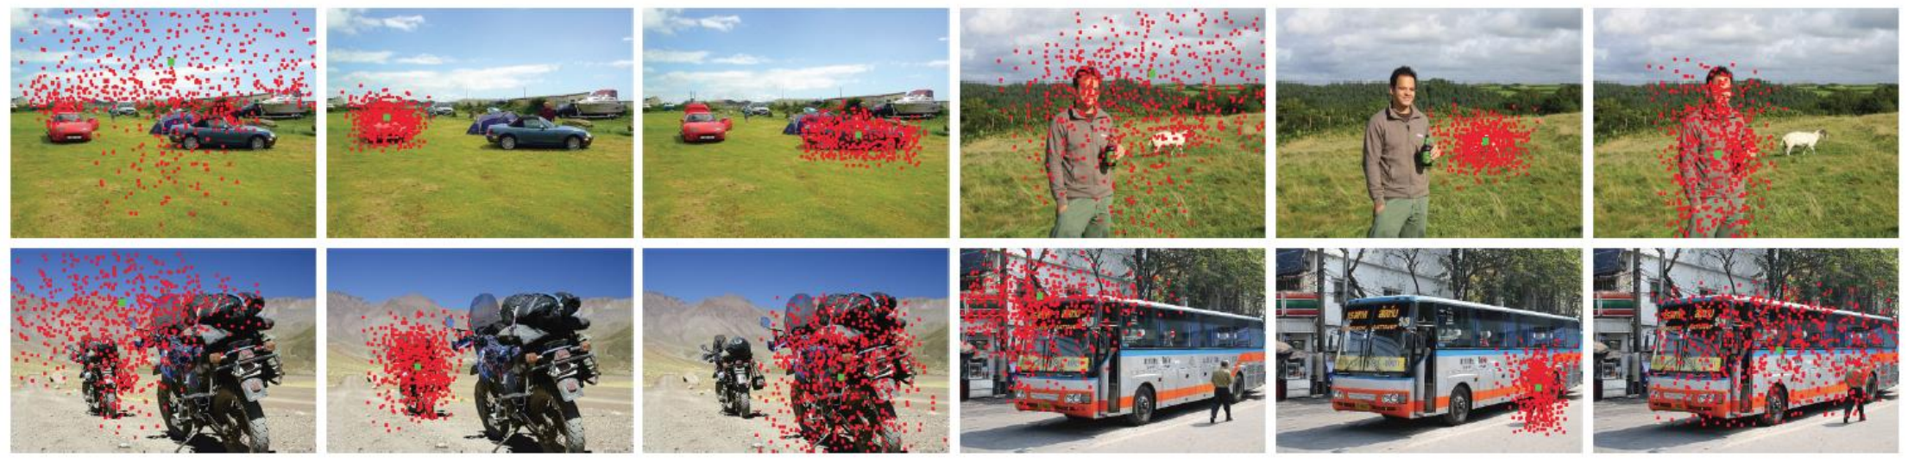
Benefits
Local, Dense and Adaptive
Dynamic and learnable receptive field

Slide 17
Benefits
Local, Dense and Adaptive
Dynamic and learnable receptive field

Slide 18
Benefits
Local, Dense and Adaptive
Dynamic and learnable receptive field
Attention embedded in Conv

Slide 19
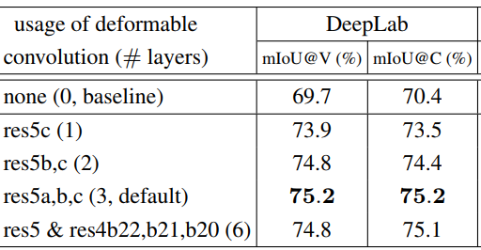
Deformable Convolutions on Segmentation
Two Branches
Regular conv. layer
another conv. layer to learn 2D offset
Generalized or “learnable” dilated (atrous) convolution
Results of using deformable convolution in the last 1, 2, 3, and 6 convolutional layers (of 3 × 3 filter) in ResNet-101 (TABLE 1)
Notes:
In this diagram, the regular conv. layer is fed in the blue squares instead of the green squares.

Slide 20
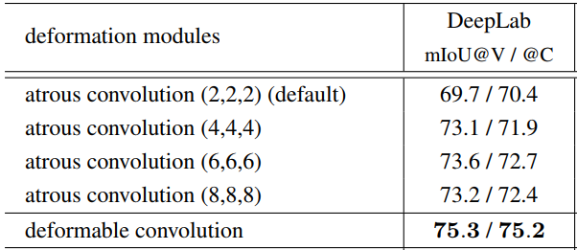
Deformable Convolutions vs Atrous Convolution
Two Branches
Regular conv. layer
another conv. layer to learn 2D offset
Generalized or “learnable” dilated (atrous) convolution
ResNet-101 (TABLE 3)
Notes:
In this diagram, the regular conv. layer is fed in the blue squares instead of the green squares.

Slide 21
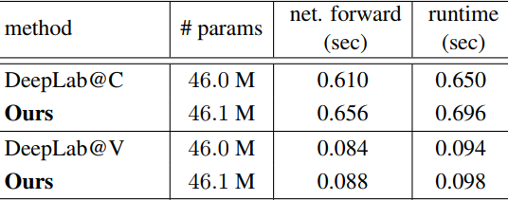
Deformable Convolutions
ResNet-101 (TABLE 4)
Notes:
In this diagram, the regular conv. layer is fed in the blue squares instead of the green squares.

Slide 22
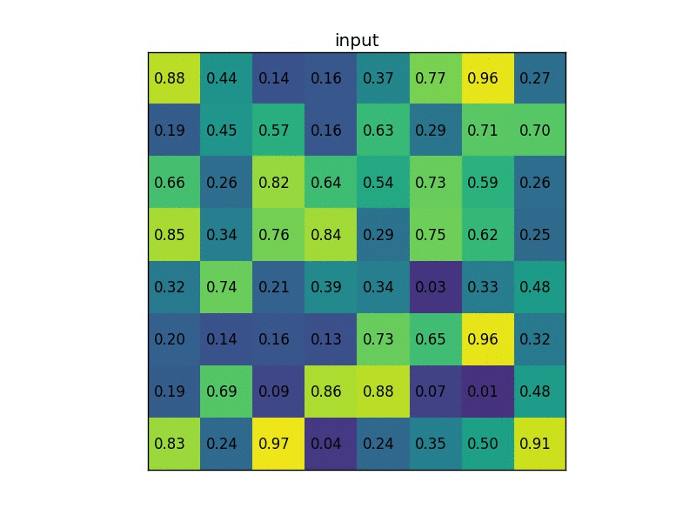
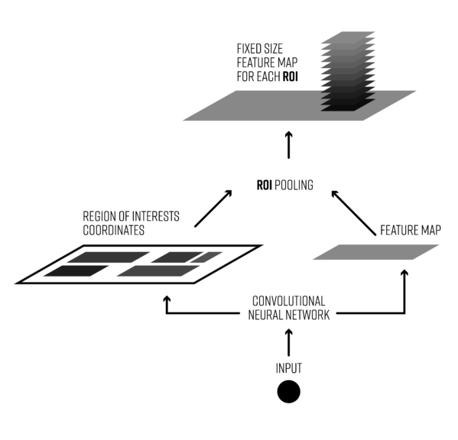
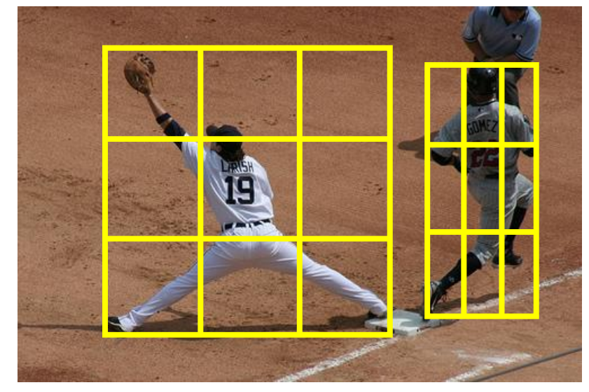
RoI Pooling
Source: https://blog.deepsense.ai/region-of-interest-pooling-explained/

Slide 23
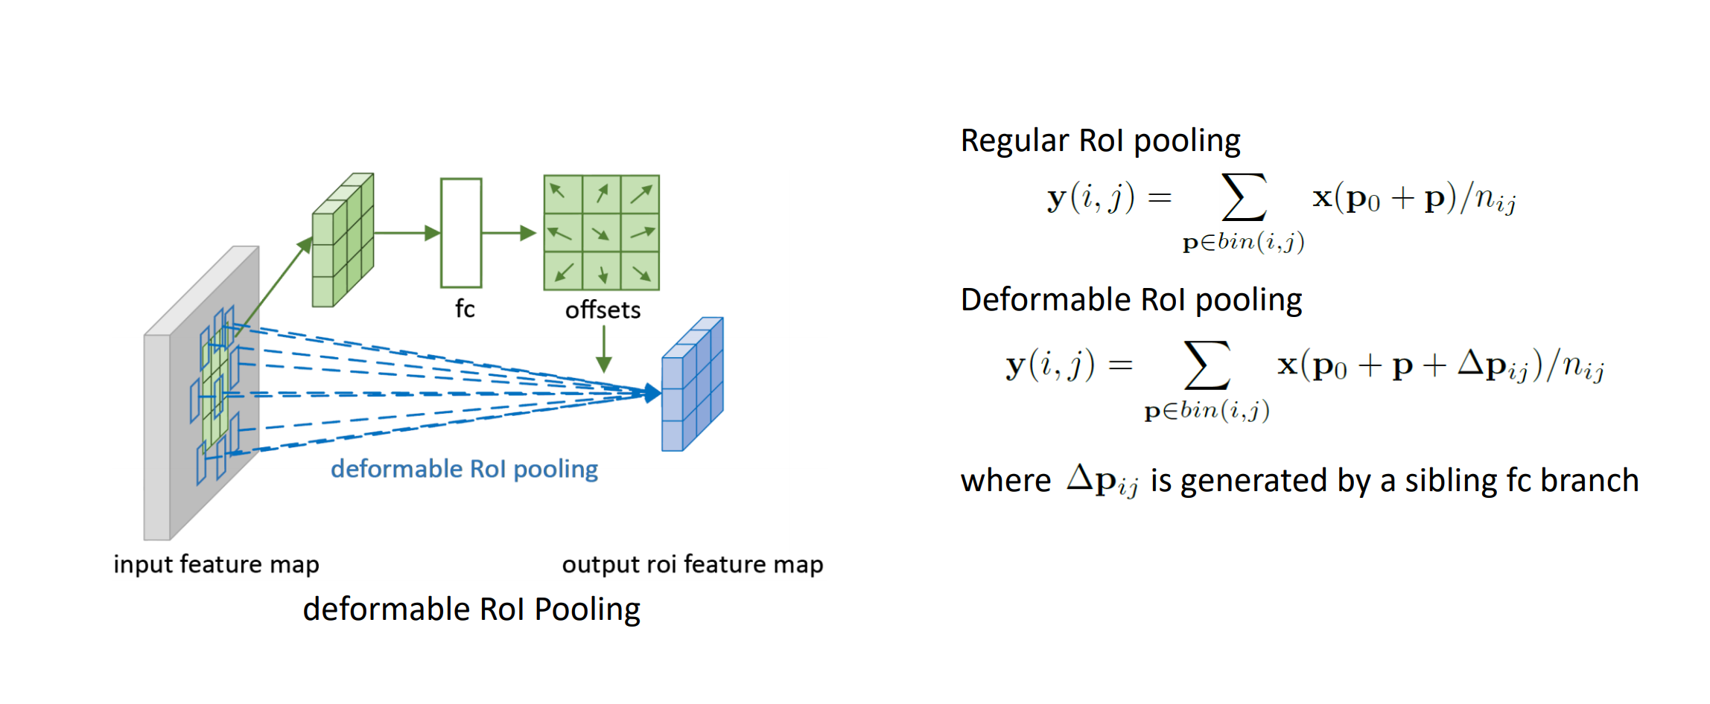
Deformable RoI Pooling
Don’t predict the raw offset
Notes:
To make these offsets invariant to RoI size.

Slide 24
Deformable RoI Pooling
Don’t predict the raw offset
Normalize offsets – invariant to ROI size
Notes:
To make these offsets invariant to RoI size.

Slide 25
Deformable RoI Pooling

Slide 26
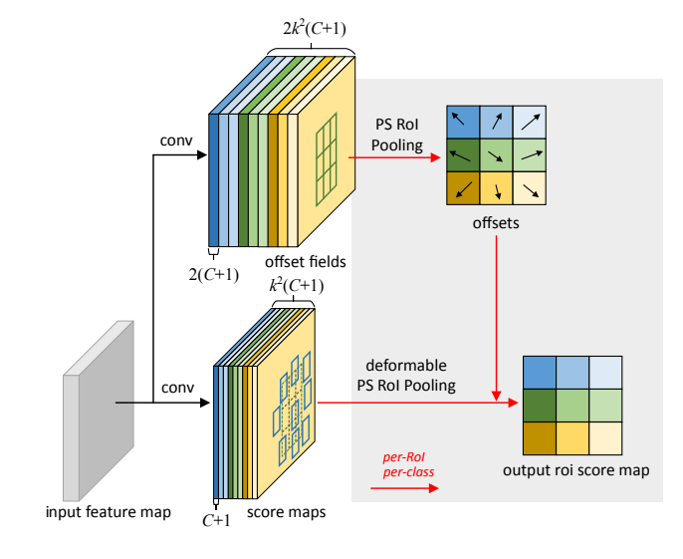
Deformable RoI Pooling
PS deformable RoI Pooling
Notes:
To make these offsets invariant to RoI size.

Slide 27
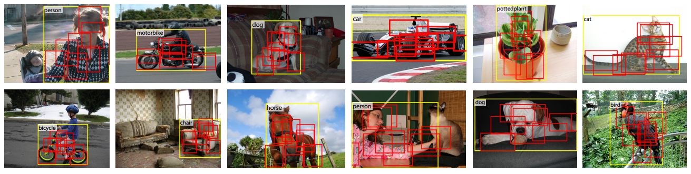
PS Deformable RoI Pooling

Slide 28
PS Deformable RoI Pooling

Slide 29
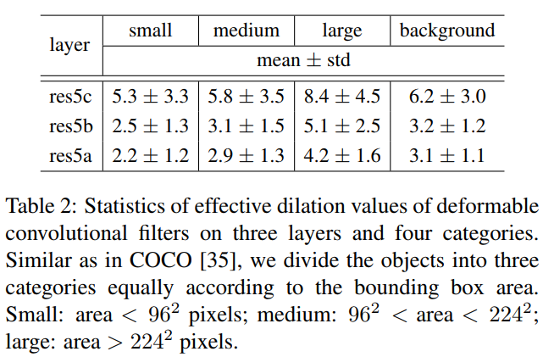
Effective Dilation

Slide 30
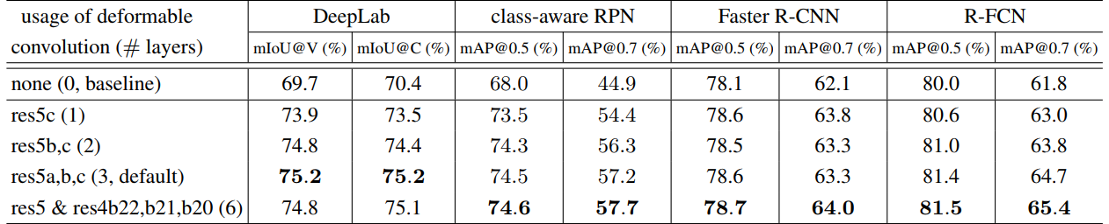
Object Detection (PASCAl VOC)

Slide 31
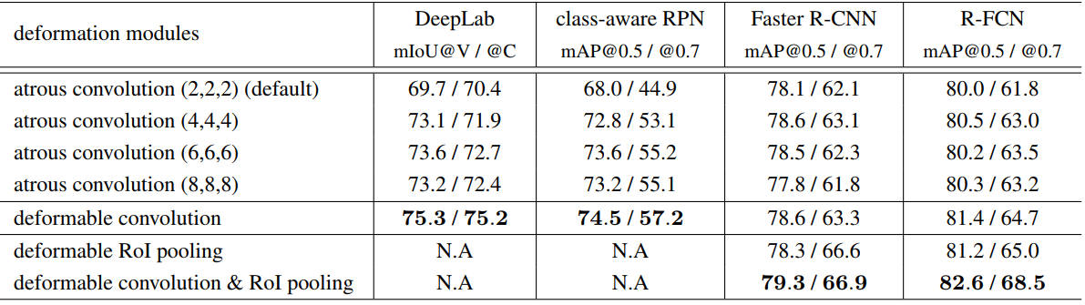
Object Detection (PASCAl VOC)

Slide 32
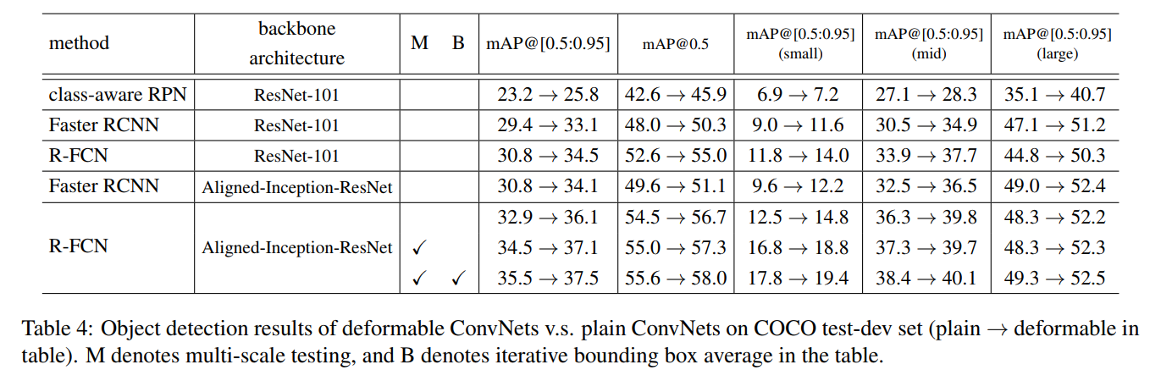
Object Detection (COCO)

Slide 33
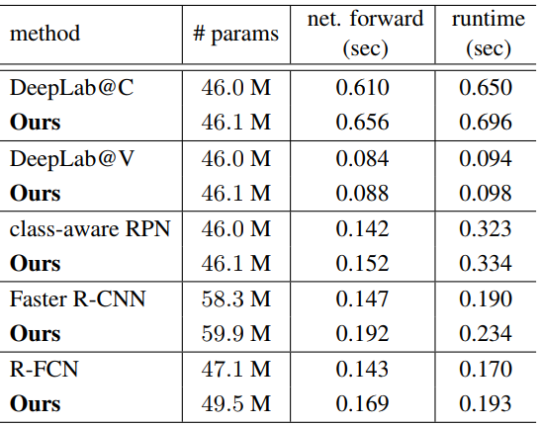
Model Complexity and Runtime Comparison

Slide 34
Robustness
ROBUSTNESS OF ROTATION-EQUIVARIANT NETWORKS TO ADVERSARIAL PERTURBATIONS (arXiv 2018)

Slide 35
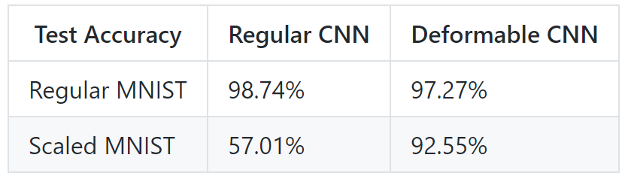
Robustness
deformable convolution is able to more effectively utilize already learned feature map to represent geometric distortion.
https://github.com/felixlaumon/deform-conv
Notes:
a forward pass with deformed convolution takes 260 ms, while regular convolution takes only 10 ms. Also, GPU average utilization is only around 10%

Slide 36
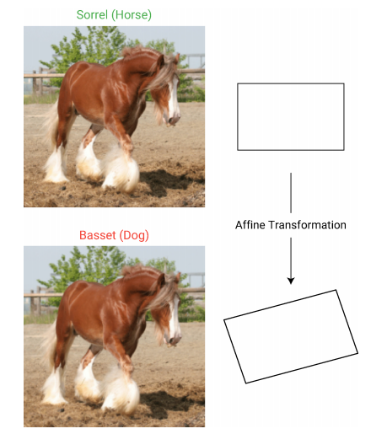
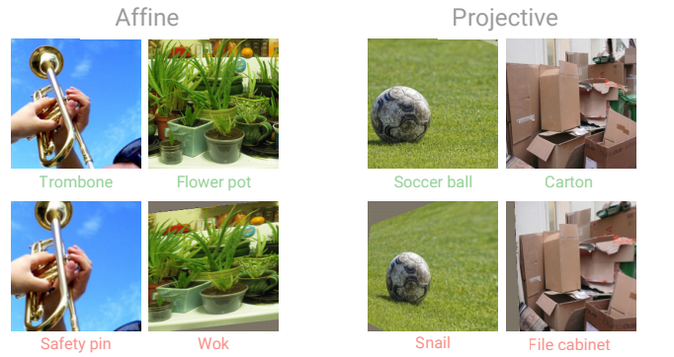
Questions to think about
Can Deformable Conv add stability to a ‘fooling’ from affine transform? [1]
Can spatially transformed adversarial examples be contained? [2]
1. Geometric robustness of deep networks: analysis and improvement (CVPR 2018)
2. Spatially Transformed Adversarial Examples (ICLR 2018)

Slide 37
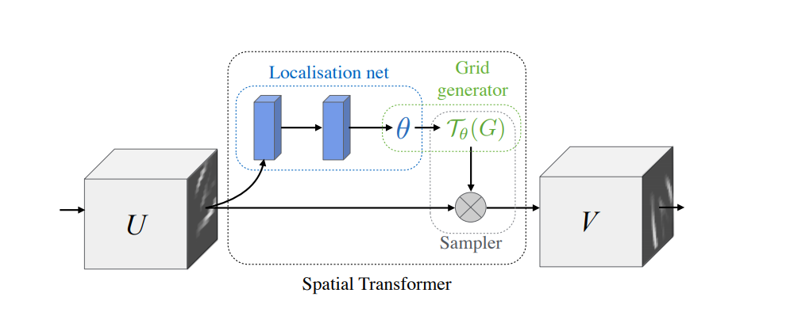
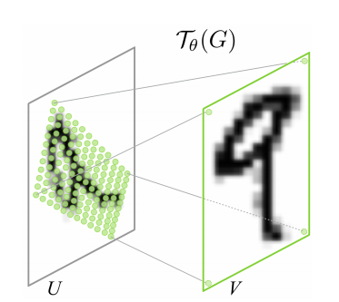
Related Work
Spatial Transformer Network (NIPS 2015)
Jaderberg, Max, Karen Simonyan, and Andrew Zisserman. "Spatial transformer networks." NIPS 2015.

Slide 38
Related Work
Spatial Transformer Network (NIPS 2015)
Dynamic Filter Networks (NIPS 2016)
Conditioned on Input features like Deformable Convolutions
Filters weights are learned and not sampling locations
Jaderberg, Max, Karen Simonyan, and Andrew Zisserman. "Spatial transformer networks." NIPS 2015.
Jia, Xu, Bert De Brabandere, Tinne Tuytelaars, and Luc V. Gool. "Dynamic filter networks.“ NIPS 2016.

Slide 39
Unanswered Questions
Does this reduce data augmentation?

Slide 40
Unanswered Questions
Does this reduce data augmentation?
Are they equally adaptable to Pooling and multiple conv kernels?

Slide 41
Unanswered Questions
Does this reduce data augmentation?
Are they equally adaptable to Pooling and multiple conv kernels?
Do they reduce model complexity if trained from scratch?

Slide 42
Unanswered Questions
Does this reduce data augmentation?
Are they equally adaptable to Pooling and multiple conv kernels?
Do they reduce model complexity if trained from scratch?
Vulnerable to attacks?

Slide 43
Graph Neural Networks

Slide 44
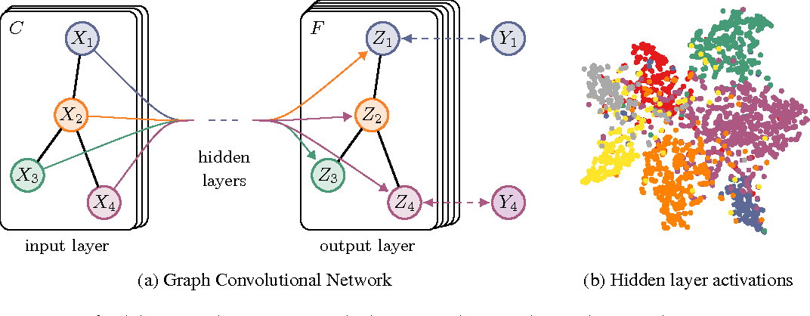
Graph Convolutional Network
Image Credits: Kipf, Thomas N., and Max Welling. "Semi-supervised classification with graph convolutional networks." arXiv preprint arXiv:1609.02907 (2016).

Slide 45
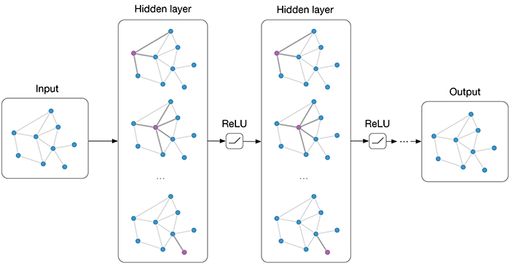
Applications
Social Networks
Protein-Protein Interaction
3D Meshes
Clustering
Scene Graphs
Survey: Bronstein, Michael M., et al. "Geometric deep learning: going beyond euclidean data." IEEE Signal Processing Magazine34.4 (2017): 18-42.

Slide 46
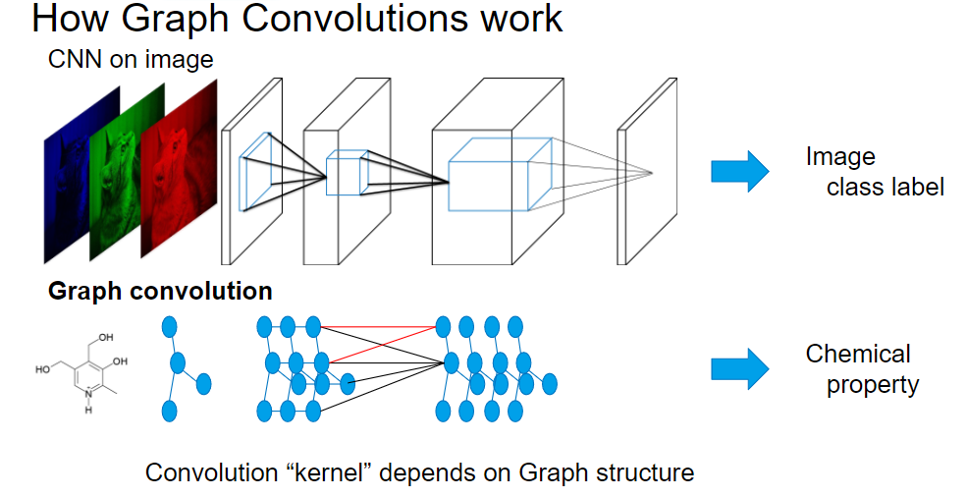
CNN vs GCNN
Image Credit: https://preferredresearch.jp/2017/12/18/chainer-chemistry-beta-release/

Slide 47
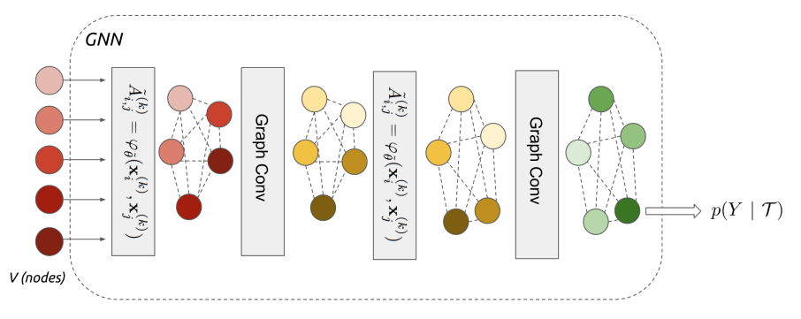
Graph Learning Problem
Given a set of nodes, each with some observed numeric attributes x_{i}
For each node, predict an output or label y_{i}
We observe these labels for some, but not all, of the nodes
A set of weighted edges, an adjacency matrix A
Message Passing like graphical models

Slide 48
Graph Learning Problem
Given a set of nodes, each with some observed numeric attributes x_{i}
For each node, predict an output or label y_{i}
We observe these labels for some, but not all, of the nodes
A set of weighted edges, an adjacency matrix A
Message Passing like graphical models

Slide 49
Graph Learning Problem
Given a set of nodes, each with some observed numeric attributes x_{i}
For each node, predict an output or label y_{i}
We observe these labels for some, but not all, of the nodes
A set of weighted edges, an adjacency matrix A
Message Passing like graphical models

Slide 50
Graph Learning Problem
Given a set of nodes, each with some observed numeric attributes x_{i}
For each node, predict an output or label y_{i}
We observe these labels for some, but not all, of the nodes
A set of weighted edges, an adjacency matrix A
Message Passing like graphical models

Slide 51
Graph Learning Problem
Given a set of nodes, each with some observed numeric attributes x_{i}
For each node, predict an output or label y_{i}
We observe these labels for some, but not all, of the nodes
A set of weighted edges, an adjacency matrix A
Message Passing like graphical models

Slide 52
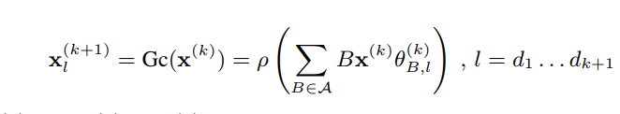
Understanding Graph Neural Networks
Eq 2 of the paper

Slide 53
Understanding Graph Neural Networks
Eq 2 of the paper

Slide 54
Understanding Graph Neural Networks
Eq 2 of the paper

Slide 55
Understanding Graph Neural Networks
Eq 2 of the paper

Slide 56
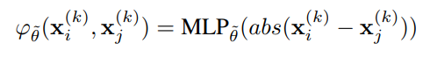
Understanding Graph Neural Networks
Eq 2 of the paper
Adjacency Matrix (Eq 4 of the paper)

Slide 57
Problem Setup
t: number of images to classify
Notes:
When r = 0, t = 1 and s = qK, there is a single image in the collection with unknown label. If moreover each label appears exactly q times, this setting is referred as the q-shot, K-way learning.

Slide 58
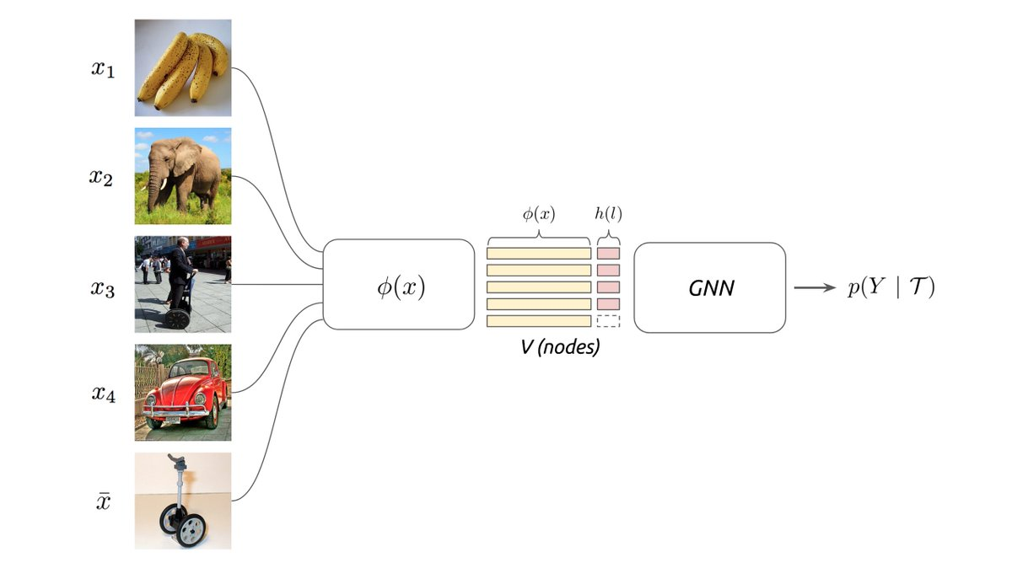
Problem Setup
Few Shot Learning: r=0, t=1, s=qk (q-shot, k-way learning)
t: number of images to classify
Notes:
When r = 0, t = 1 and s = qK, there is a single image in the collection with unknown label. If moreover each label appears exactly q times, this setting is referred as the q-shot, K-way learning.

Slide 59
Problem Setup
Few Shot Learning: r=0, t=1, s=qk (q-shot, k-way learning)
Semi-Supervised Learning: r>0 and t =1
t: number of images to classify
Notes:
the input collection contains auxiliary images that the model can use to improve the prediction accuracy, b

Slide 60
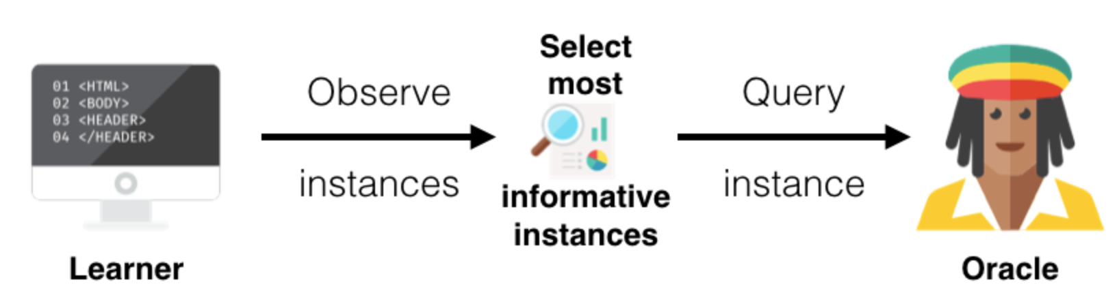
Problem Setup
Few Shot Learning: r=0, t=1, s=qk (q-shot, k-way learning)
Semi-Supervised Learning: r>0 and t =1
Active Learning: Request labels for
t: number of images to classify
Image Credits: https://www.datacamp.com/community/tutorials/active-learning
Notes:
In the active learning setting, the learner has the ability to request labels from the sub-collection

Slide 61
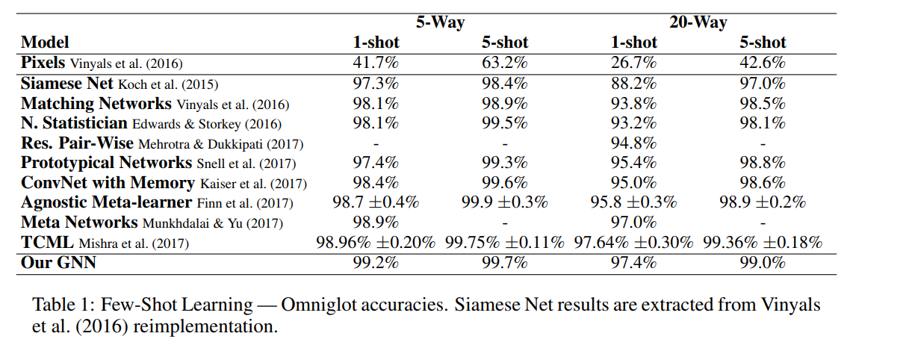
Few Shot Learning Experiments

Slide 62
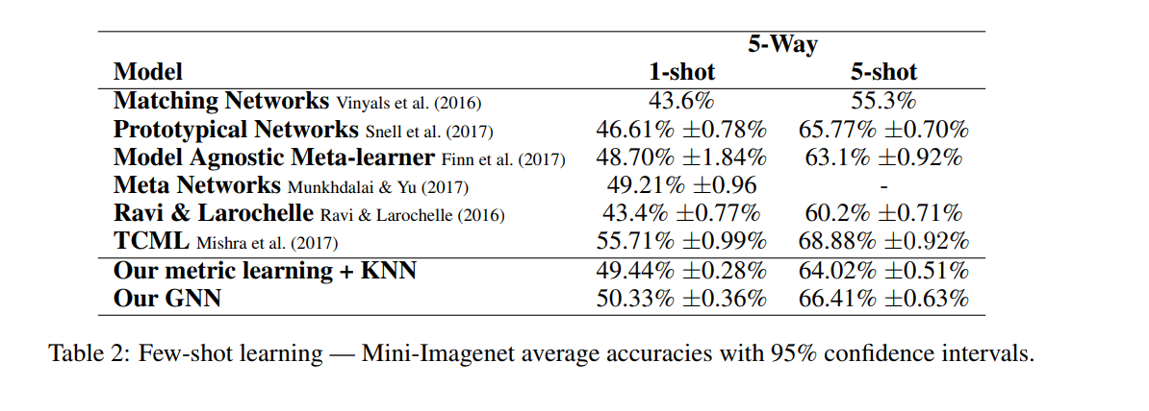
Few Shot Learning Experiments

Slide 63
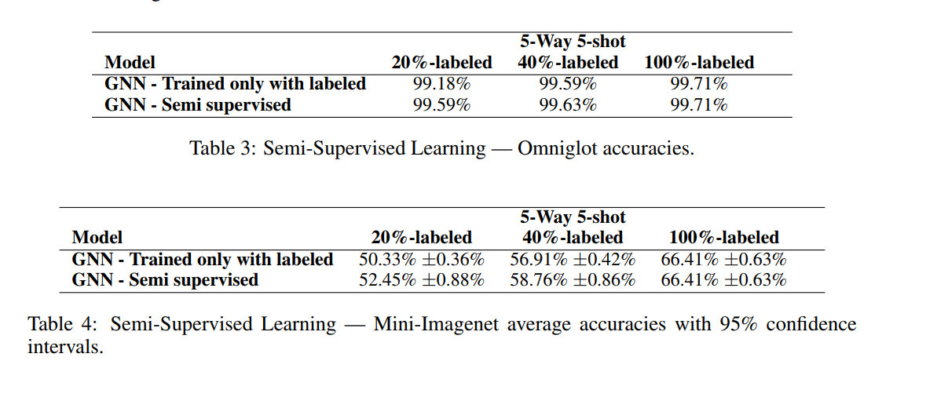
Semi-Supervised Experiments

Slide 64
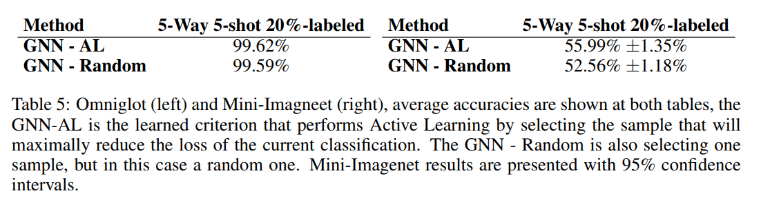
Active Learning Experiments

Slide 65
Kipf and Welling (ICLR 2017)
Generalization of convolutions, and easiest to define in spectral domain
Fourier transform scales poorly with size of data so we need relaxations
First order approximation in Fourier-domain to obtain an efficient linear-time graph-CNNs
Modelling power is severely impoverished, due to the first-order and other approximations made.
Thomas N. Kipf and Max Welling (2016) Semi-Supervised Classification with Graph Convolutional Networks
Ferenc Huszar’s blog: https://www.inference.vc/how-powerful-are-graph-convolutions-review-of-kipf-welling-2016-2/

Slide 66
Kipf and Welling (ICLR 2017)
Generalization of convolutions, and easiest to define in spectral domain
Fourier transform scales poorly with size of data so we need relaxations
First order approximation in Fourier-domain to obtain an efficient linear-time graph-CNNs
Modelling power is severely impoverished, due to the first-order and other approximations made.
Thomas N. Kipf and Max Welling (2016) Semi-Supervised Classification with Graph Convolutional Networks
Ferenc Huszar’s blog: https://www.inference.vc/how-powerful-are-graph-convolutions-review-of-kipf-welling-2016-2/

Slide 67
Kipf and Welling (ICLR 2017)
Generalization of convolutions, and easiest to define in spectral domain
Fourier transform scales poorly with size of data so we need relaxations
First order approximation in Fourier-domain to obtain an efficient linear-time graph-CNNs
Modelling power is severely impoverished, due to the first-order and other approximations made.
Thomas N. Kipf and Max Welling (2016) Semi-Supervised Classification with Graph Convolutional Networks
Ferenc Huszar’s blog: https://www.inference.vc/how-powerful-are-graph-convolutions-review-of-kipf-welling-2016-2/

Slide 68
Kipf and Welling (ICLR 2017)
Generalization of convolutions, and easiest to define in spectral domain
Fourier transform scales poorly with size of data so we need relaxations
First order approximation in Fourier-domain to obtain an efficient linear-time graph-CNNs
Modelling power is severely impoverished, due to the first-order and other approximations made.
Thomas N. Kipf and Max Welling (2016) Semi-Supervised Classification with Graph Convolutional Networks
Ferenc Huszar’s blog: https://www.inference.vc/how-powerful-are-graph-convolutions-review-of-kipf-welling-2016-2/

Slide 69
Limitations
Brittle – Also see, On Computational Hardness with Graph Neural Networks. Joan Bruna [video]

Slide 70
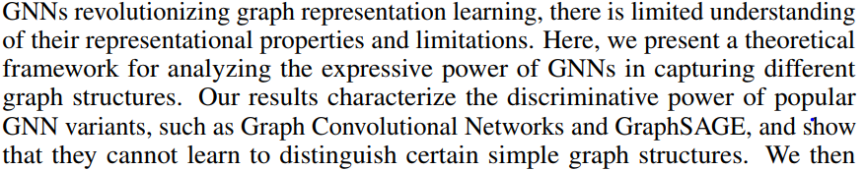







Limitations
Brittle – Also see, On Computational Hardness with Graph Neural Networks. Joan Bruna [video]
How powerful are graph neural networks? [arXiv, 10/01/2018]

Slide 71
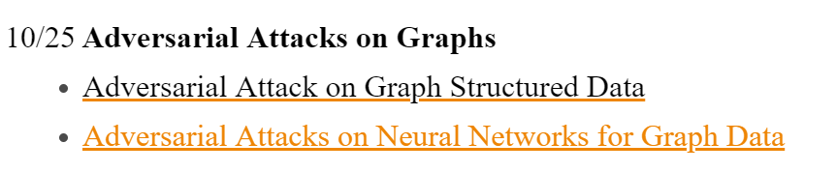
Attacks on Language-Vision problems?
Image Captioning [this]
Visual Dialog
Scene Graph Generation

Slide 72
Related Work
Bronstein, Michael M., et al. "Geometric deep learning: going beyond euclidean data." IEEE Signal Processing Magazine34.4 (2017): 18-42. [paper]
Schlichtkrull, Michael, et al. "Modeling relational data with graph convolutional networks." European Semantic Web Conference. Springer, Cham, 2018. [paper]
Wang, Nanyang, et al. "Pixel2Mesh: Generating 3D Mesh Models from Single RGB Images." ECCV (2018). [paper]
Yang, Jianwei, et al. "Graph R-CNN for Scene Graph Generation." ECCV (2018). [paper]

Slide 73
Other Questions on g-sheets
In "Deformable Convolutional Networks", for position-sensitive RoI pooling, why do we need C+1 for C object classes? [Background]
I don’t see how deformable convolution can help against adversarial examples since everything is differentiable too. [Can break classifiers, will make detectors more robust]
On Deformable Conv, How is this different from using a large kernel with dropout per filter application [Not sure]
Few-Shot Learning with Graph Neural Networks: Why the particular choice of pointwise abs in Eq 4, as opposed to something else? (Like pointwise squared distance) [features are more representative]

Slide 74
Other Questions on g-sheets
Deformoable convolution is just an extreme case of self attention. Why don't the authors use self attention? [Yes, but self-attention doesn’t provide invariance properties to CNN]
In GCN, is there a way to use GCN as an unsupervised feature extractor on graph to learn node embedding. [GCN are inherently clustering nodes – maybe extract mean features of each cluster]
Have trouble understanding the graph operations. Would like to get an explanation [Hopefully, it’s clear now]
Deformable Convolutional Networks": Could the deformable convolutional layers be extended to be useful in generative models as well? [Interesting question - I don’t think they would add anything substantial]

